Slide 1
Chapter 5 – Model quality
Artificial Intelligence

Slide 2

Disclaimer
This ppt is a summary of a notebook
Don’t study this ppt, but study the notebook
It has more (and nicer) examples

Slide 3
Cat or not cat?
This powerpoint uses the very bad “is it a cat or not a cat”-model
This is a bad model for 2 reasons:
Cat or not cat is a deep learning model, where we are working with machine learning. The results of a machine learning model are the same though, but less graphical (a fraudulent transaction is nowhere near as cute as a cat).
The model is awful. Any script-kiddy copying from youtube can make a better cat-dog model. The reason we work with such a bad model is because that makes it easier to align the results with the model. (0,9987 is less than 0,99978, but it easier to see the difference between 0,18 and 0,64)

Slide 4
Train, test, validation
You split your data in three parts. The exact percentages differ, but training is the biggest (70%-80%), and the remainder is divided equally between validation and test.
Data should be divided using the same probability distributions. (Don’t take the top X rows from a sorted dataset.)
Sometimes you only use a training and a test-set:
Train the model and test it once
When you can adjust parameters on the model, you need a validation-set
Train model using param X, validate, set param Y, train again, validate, …
Finally test the final model using the (until then unseen) test-set
Notes:
https://en.wikipedia.org/wiki/Training,_validation,_and_test_data_sets

Slide 5
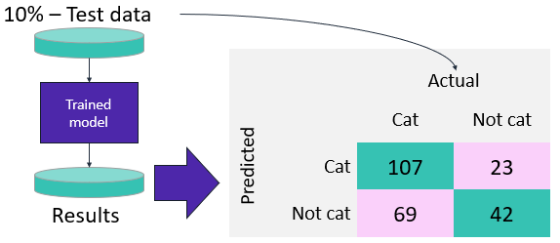
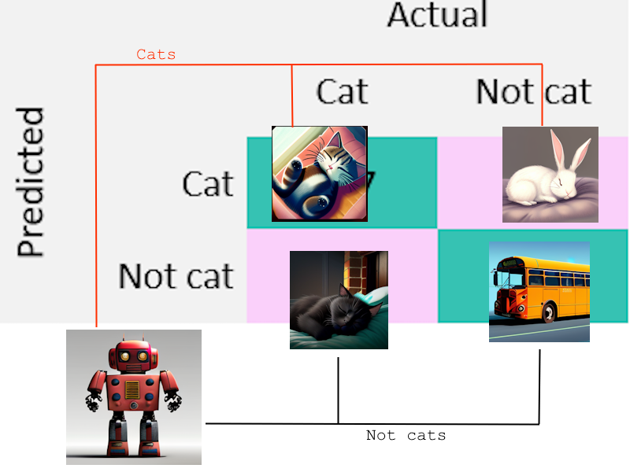
Confusion matrix
A very simple confusion matrix for a binary classifier
With examples:
True positive (TP) Predicted a cat and it was a cat
False positive (FP) Predicted not a cat and it was a cat
False negative (FN) Predicted a cat and it was not a cat
True negative (TN) Predicted not a cat and it was not a cat

Slide 6
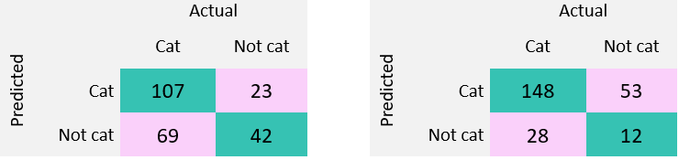
Confusion matrix
A confusion matrix sounds easy, but which of the above is the better model?
Left model got 92 images wrong, the one on the right only 81.
The one on the right also labels a lot of images as cats. Is that a problem?

Slide 7
Sensitivity
Sensitivity measures the proportion of actual positive instances that are correctly identified by the model.
Sensitivity = TP / (TP + FN)
High sensitivity: model is good at identifying positive instances
Example: in a medical setting low FN is important as it’s better to have received treatment for an illness you don’t have that to not have treatment for an illness you do have.

Slide 8
Specificity
True negative rate, the opposite of sensitivity
Specificity = TN / (TN + FP)
High specificity: model is good at finding negative instances
Example: In a security-system high specifity will keep down the false alarms

Slide 9
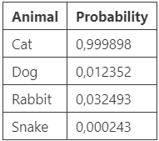
Thresholds
Basic models (decision trees, random forests, …) return a binary classifier. More advanced models (XGBoost, linear learner, …) tend to give a probability
Example:
You may state an animal is a cat if the probability of “cat” is higher than all other animals. But what if we upload a bus an cat is 0,00021% and dog is 0,00018%?
Changing the thresholds is an easy way of changing sensitivity and specificity. Could we make a graph of the different settings to choose the best one?

Slide 10
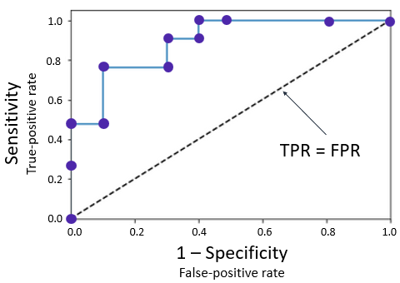
ROC
A receiver operating characteristic (ROC) graph summarizes all the confusion matrices that each threshold produced. To build one, you calculate the sensitivity (or true-positive rate) against the false-positive rate for each threshold value.
(0,0): Everything is a cat
(1,1): Everything is not a cat
(0,1): Best possible model
(1,0): Worst possible model
Line from (0,0) to (1,1): random classifier
Best model, wrong labels!

Slide 11
ROC
The ROC does not help improving the model, it helps tuning the model to the use case
False positives are a major issue?
False negatives are a major issue?
You need a well balanced model?
An ROC does show if a model is better if it’s further away from the diagonal
The diagonal is a random classifier: wrong as much as it is right

Slide 12
AUC-ROC
Suppose you have a new dataset and created some ROC-curves for different models. What easy way is there to see which is the better model?
Measure the area under the curve! Bigger means further from diagonal, means better.
A percentage of 100% would be an ROC-curve that fills the entire surface, a perfect model.
A percentage of 50% would be an ROC-curve that exactly follows the diagonal, which is the worst model possible (a random estimator).
A percentage of 0% would be another perfect model with bad labeling.

Slide 13
Accuracy
Sensitivity and specificity only look at two of the values of the confusion matrix
Accuracy looks at all four
Accuracy = (TP + TN) / (TP + TN + FP + FN)
It’s a good general matrix, but tends to miss low specificity

Slide 14
Precision and F1-score
When false positives are a problem, precision is a good metric
Precision = TP / (TP + FP)
F1-score (or F-measure or balanced F-score) calculates the harmonic mean of precision and sensitivity
Good for both balanced and imbalanced datasets
F1 = (2* precision * sensitivity) / (precision + sensitivity)

Slide 15
Summary
Sensitivity (or recall): find positive instances
Sensitivity = TP / (TP + FN)
Specificity: find negative instances
Specificity = TN / (TN + FP)
ROC: alter thresholds, draw curve
AUC-ROC: Area under said curve (as percentage)
Accuracy: Use all the metrices
Accuracy = TP + TN / (TP + TN + FP + FN)
Precision: use when false positives are a problem
Precision = TP / (TP + FP)
F1-score: use on imbalanced datasets
F1 = (2* precision * sensitivity) / (precision + sensitivity)

Slide 16
Regression
Just to be clear: all these metrics only work when doing classification
“Is it going to be good or bad weather?”
“Can I win the tour de Flanders for amateurs?”
“How many years would it take for this student to graduate?”
When doing regression…
“What will the temperature be?”
“Which position could I get in the the tour de Flanders for amateurs?”
“What are the odds of this student graduating in three years?”
Use RMSE

Slide 17
Back to work!
As said before, this slide is available as a notebook.
After that we’ll use PyCaret
Give it some data
PyCaret creates a bunch of models for us
We check the parameters and decide which we want to use
But first we need to install PyCaret, which is tricky

